Slide 1

Command Design Pattern
Archit.s
Yash.r
Ruben.m

Slide 2
Overview
The Command Pattern
The Command pattern is a behavioural design pattern in which an object is used to represent and encapsulate all the information needed to call a method at a later time.
The information includes the method name, the object that owns the method and values for method parameters.
This helps us in parameterizing clients with different requests, queue or log requests and support undoable operations

Slide 3
Command Pattern : Participants
Command declares an interface for executing an operation
ConcreteCommand implements execute() by invoking the operations on receiver.
Client creates the receiver objects and the ConcreteCommand objects.
Invoker transfers the command to the receiver.
Receiver is a class that actually knows how to perform the commands

Slide 4
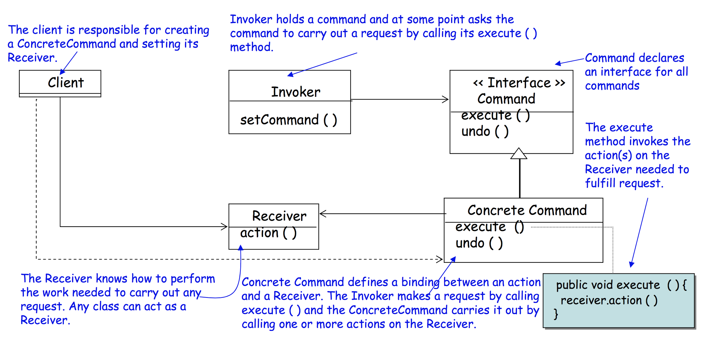

Slide 5
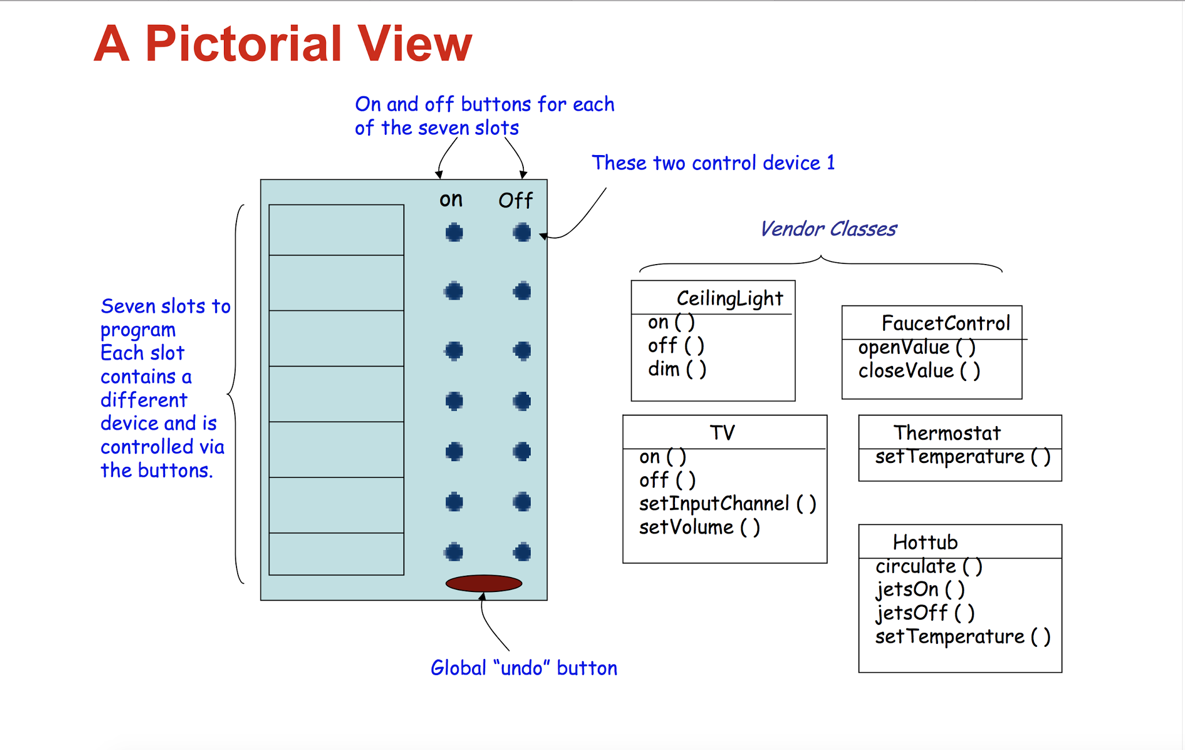
Example - Program a Remote Control that can be used to control the devices in the house.
09.05.XX
10.13.XX
10.20.XX
11.01.XX

Slide 6
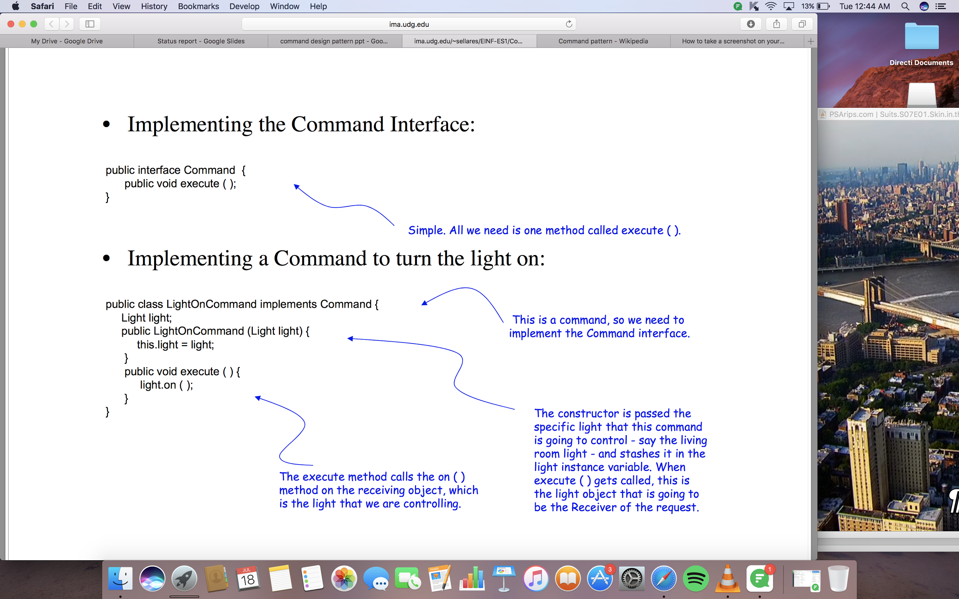
Command Pattern allows you to decouple the requester of an action from the object that actually performs the action:
– Requester == remote control, Object == vendor classes
09.05.XX
10.13.XX
10.20.XX
11.01.XX

Slide 7
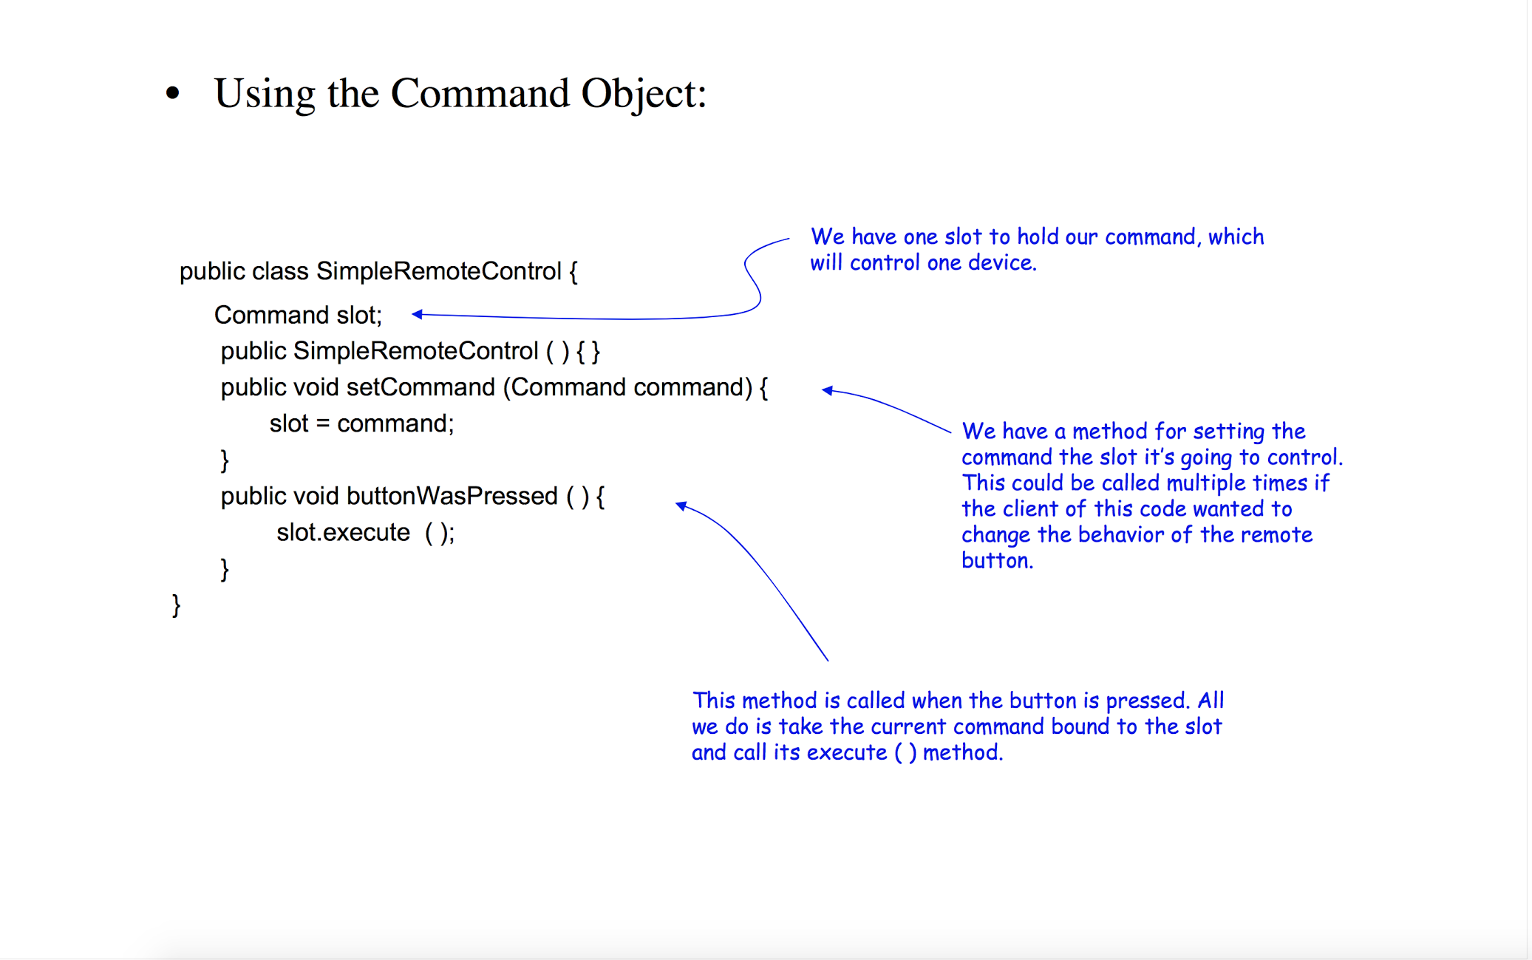
09.05.XX
10.13.XX
10.20.XX
11.01.XX

Slide 8
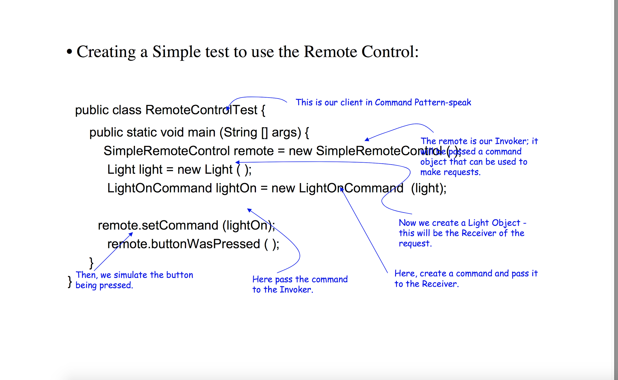
09.05.XX
10.13.XX
10.20.XX
11.01.XX

Slide 9
Real life Example
Create a record in DB.
Call a service to update a related record.
Call another service to log a ticket.
To perform this in a transactional manner, each operation is implemented as a command with undo operation. At the end of each step, the command is pushed onto a stack. If the operation fails at some step, then we pop the commands from the stack and call undo operation on each of the command popped out. The undo operation of each step is defined in that command implementation to reverse the earlier command.execute().
09.05.XX
10.13.XX
10.20.XX
11.01.XX

Slide 10
Why?
Command design pattern is used to implement decoupling in a request-response model.
Extensions is easy and can be done without changing the existing code.
You can also define a rollback system with the Command pattern.

Slide 11
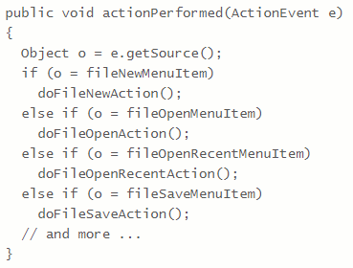

Slide 12
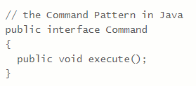
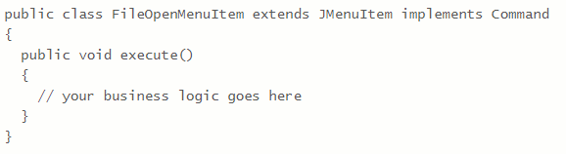
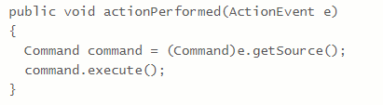

Slide 13
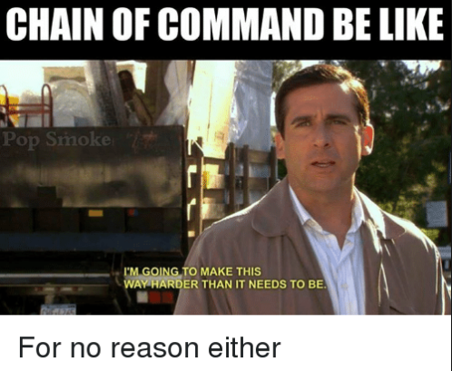
Disadvantages
Increases the Number Of Classes
Causes confusion during implementation
I’m Going to make it way harder than it needs to be

